Slide 1
Data Science Challenge Philip Morris International Fábio Oliveira

Slide 2
Table of contents
Explanatory analysis
Pre-processing
Question 1
Question 2
Question 3

Slide 3
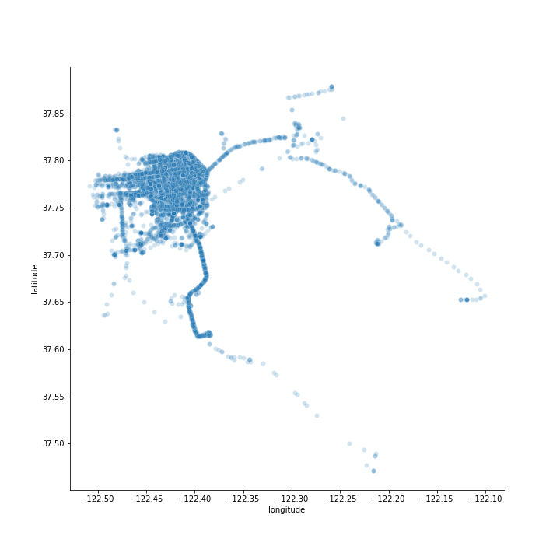
Explanatory analysis Single cab data evaluation
First I tried to understand the cab driver mobility
San Francisco city limits can be clearly seen
Two zones with high movements. One at the San Francisco downtown and another one at the airport

Slide 4
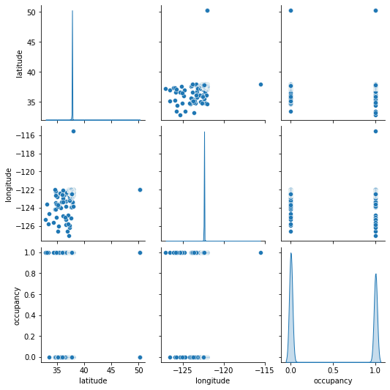
Explanatory analysis Complete cab data evaluation
No longer can see San Francisco city limits
Latitude and longitude distribution very compact at the centre
Both these factors indicate the presence of outliers (bad GPS readings)
Seems that cabs spend more time roaming then with clients

Slide 5
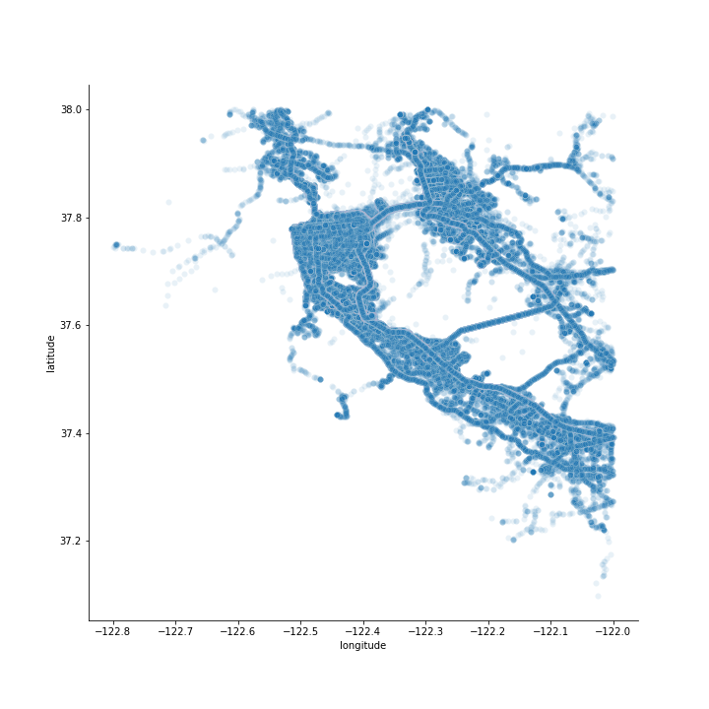
Pre-processing Outlier removal and feature engineering
Performed feature engineering to add information about distance, time and velocity between points
Used velocity to determine outliers, setting the threshold at 85 mph (maximum velocity in the US)
This method allowed minimal lost of information, when comparing with other methods

Slide 6
Question 1 Potential for yearly reduction on CO2 emissions due to roaming
Assumptions
Electric cars have 0 emission (tank-to-wheel)
Internal combustion cars emit 404 g of CO2 per mile
Initial fleet has 537 cabs
Cab fleet is changing at the rate of 15% per month (at the beginning of the month)
Movement in the given time frame is representative
We are at the beginning of 2020 (no COVID impact)

Slide 7
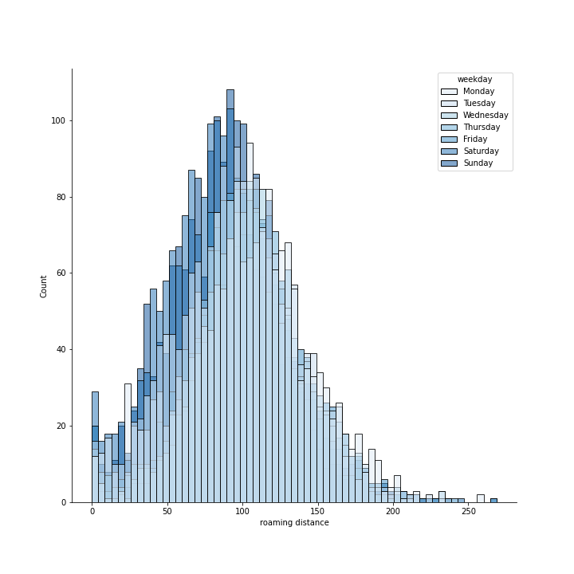
Question 1 Potential for yearly reduction on CO2 emissions due to roaming
Due to the lack of data, two options were possible. Calculate potential using the roaming distance per week or per weekday.
Significant differences of roaming distance between the working day as the weekend
Due to these differences I opted per the weekday option, and calculated the potential for yearly reduction of CO2 emission

Slide 8
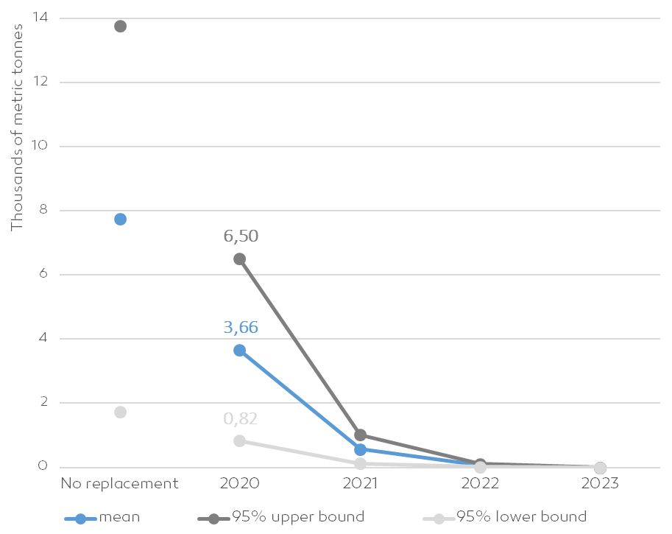
Question 1 Potential for yearly reduction on CO2 emissions due to roaming
Potential reduction of CO2 in the first year (with replacement) is 3,66 thousand metric tonnes
Potential decreases over the years until the 2023, when it reaches 0 (due to the fleet replacement)
Without replacement the potential for yearly reduction on the first year would be much higher (~8 thousand metric tonnes)

Slide 9
Question 2 Predict the next place a passenger will hail a cab
Approach to the problem
Opted to use as a label the number of pickup of clients per area
The definition of areas was made using the h3 package from Uber which divides the Earth in hexagons
Evaluated the pickups variation over time using the areas with a good volume of data (more than 1000 pickups), using decomposition techniques
Develop a predictive model for the number of pickups per area per hour
Predicted the number of pickups for the next day for the various areas and defined hot areas for each hour (next place a passenger will hail a cab)

Slide 10
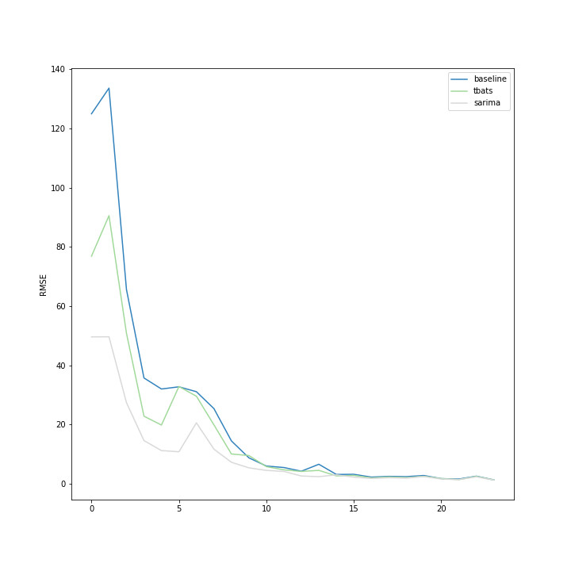
Question 2 Predict the next place a passenger will hail a cab
Three models where evaluated: baseline (average from the last day), SARIMA and TBATS
Multiple error metrics (RMSE, MAE, MAPE) where used together with a cross-validation technique to evaluate the models performance
Has we can see by the graph the best model for all the defined areas was SARIMA
It was this model that was then used to make the day prediction on the test data

Slide 11
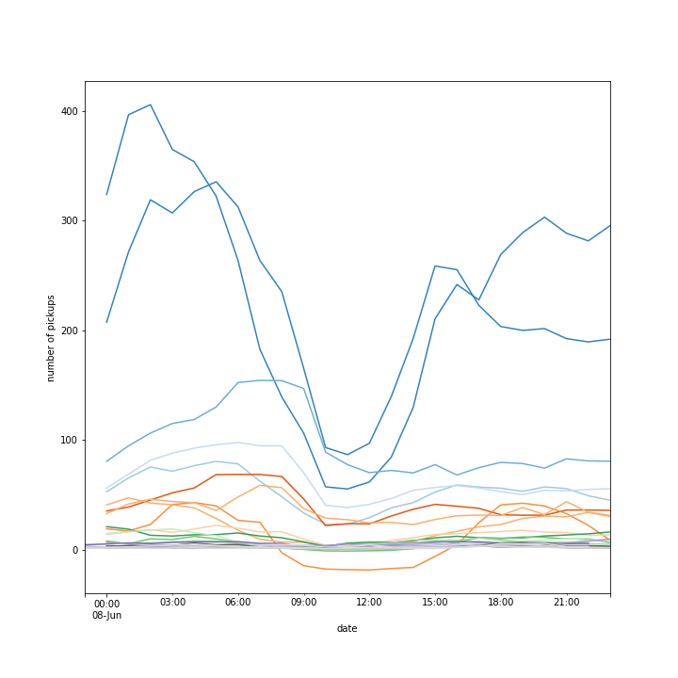
Question 2 Predict the next place a passenger will hail a cab
Using the predictions for the next day is then possible to predict the hot hours at each area
It was a Sunday but its clear that the cabs should be concentrated around San Francisco downtown around Union Square

Slide 12
Question 3 Clusters relevant from the cab company point of view
Approach to the problem
Defined a smaller areas using the h3 package and evaluated all the mobility data
Evaluated the top five location for different time windows (morning, evening and afternoon)
Identified two cluster that seemed relevant from the company point of view:
Union Square:
Although many areas in San Francisco downtown have a high number of pickups, it seems that cabs spend most of their time around this location
Potrero terrace:
This seems the location where most of the cab drivers live, or where the cabs are parked at the company. If the correct option is the first one it could be a good spot to make community events, regarding the workers.

